Slide 1
Object-Oriented Programming – Fundamentals
Sibi Chakkaravarthy Sethuraman
Centre of Excellence, Artificial Intelligence & Robotics (AIR)
School of Computer Science and Engineering
VIT-AP University

Slide 2
Module No. 1
Features of OOP – Data types, variables, Array, Operators, String function, Control statements, Objects and Classes in Java – Defining Classes – Methods - Access Specifiers – Static Members – Constructors, this Keyword-Encapsulation.

Slide 3
Why you need a programming language?

Slide 4
Which language computer knows?

Slide 5
Introduction to Programming language
1949 – Brief Code (First assembly language)
1954 – Fortran (First High level language)
1972 – Smalltalk (First High level object oriented language)

Slide 6
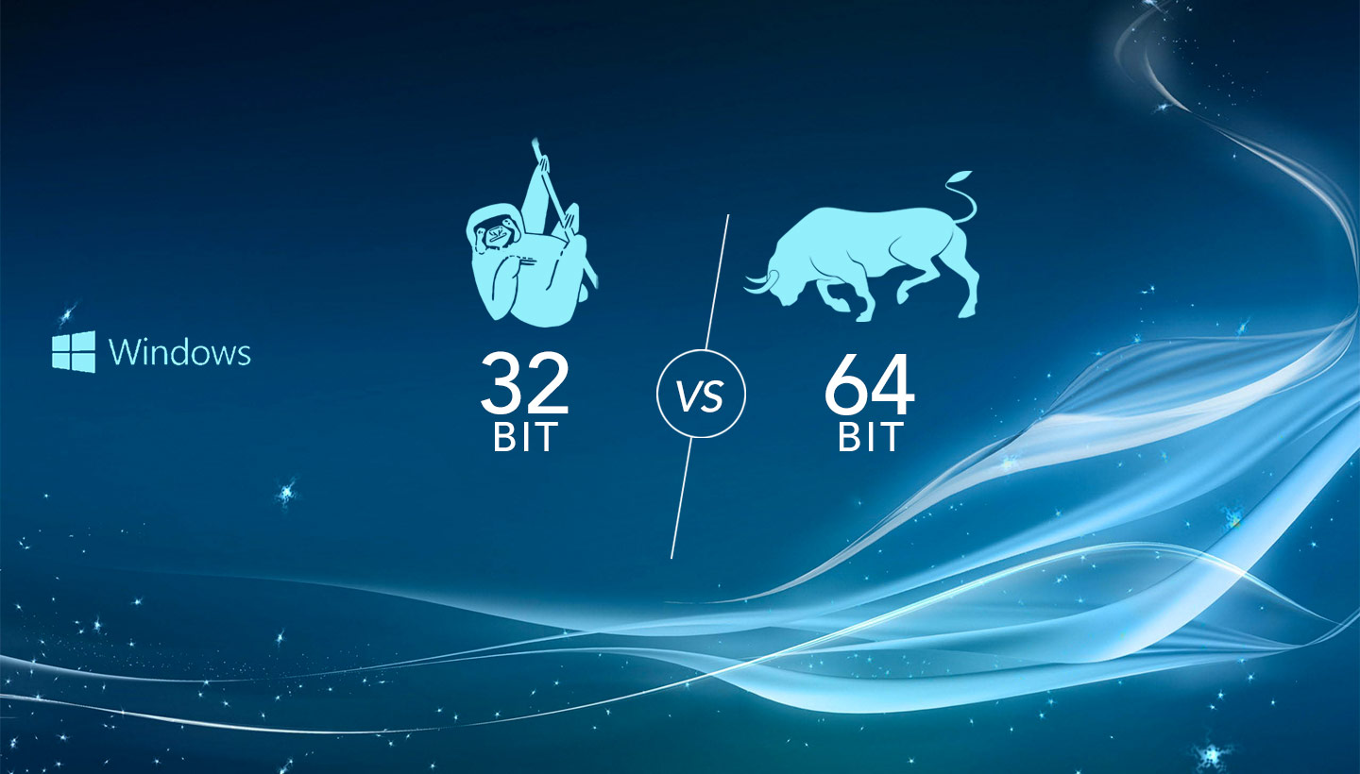
32 bit vs 64 bit

Slide 7
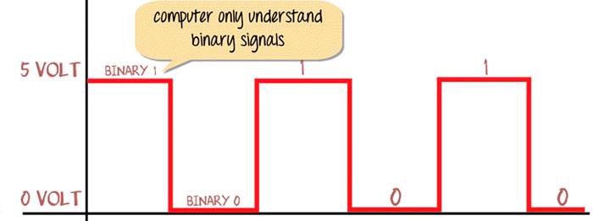
8 –bit computing

Slide 8
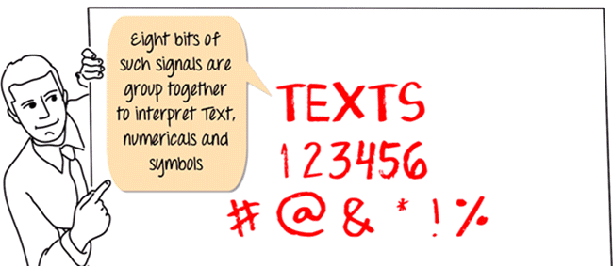
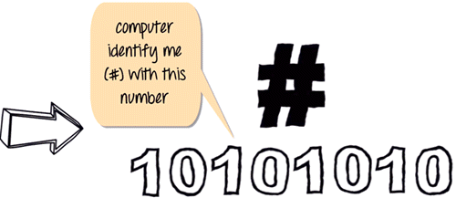
How a human sees
How a computer sees
Current day processor is capable of decoding 64-bit time

Slide 9
Current day processor is capable of decoding 64-bit time
Future gen processors are capable of decoding Qubit time

Slide 10
Problem statement
Suppose if you want to tell the computer to add two numbers (1+2) which is represented by some binary numbers (10000011), how are you going to tell the computer?

Slide 11
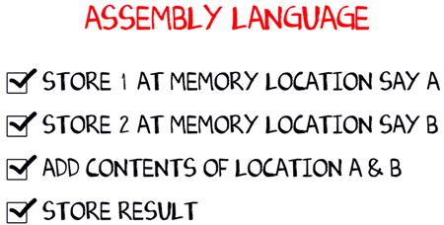
Yes, we are going to use assembly language to inform computer
"Assembly Language is the most elementary form of software development languages."

Slide 12
OMG! Computer knows only 0s and 1s
Assembly code is Ok!
Now, you informed computer about the assembly code
Assembly code is also a low level programming language (But machine knows only 0s and 1s)

Slide 13
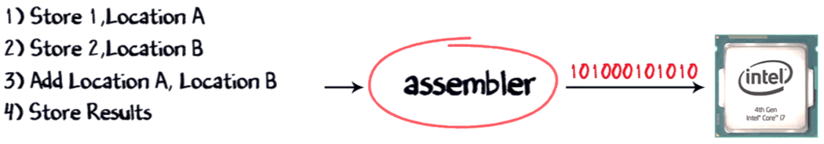
What is Assembler?
Assembler converts the assembly code into corresponding machine code (110001..) and feeds to your PC (processor)

Slide 14
Constraint in execution
PLATFORM – OS + Processor
Most common platform – Windows + Intel (Wintel)
Likewise, there are plenty of platforms (different OS, different processors) in the world.
Programming execution in one platform differs from other.

Slide 15
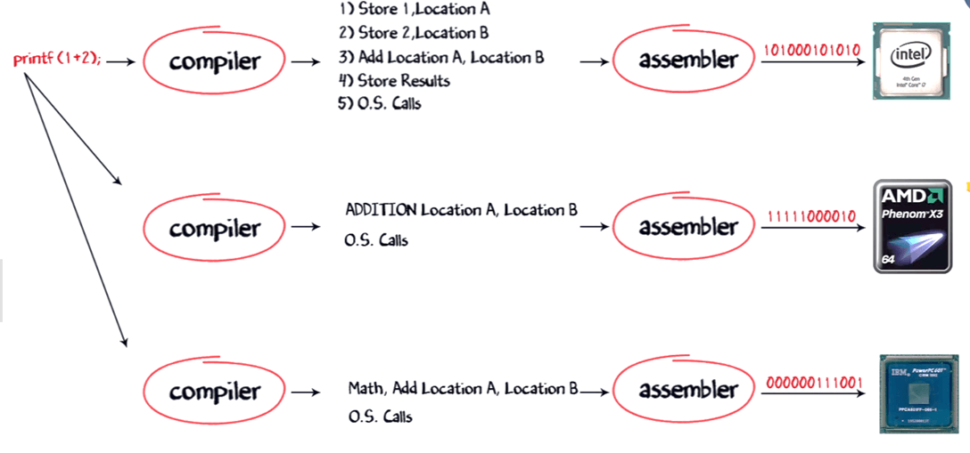
Platform independent

Slide 16
Introduction to JAVA
JAVA was developed by Sun Microsystems Inc in 1995, later acquired by Oracle Corporation.
James Gosling and Patrick Naughton

Slide 17
Some common terminologies in Java
Java Virtual Machine (JVM)
Java Development Kit (JDK)
Java Runtime Environment(JRE)
Bytecode

Slide 18
Advantages of JAVA
Java is a platform independent language
Java is an object oriented language

Slide 19
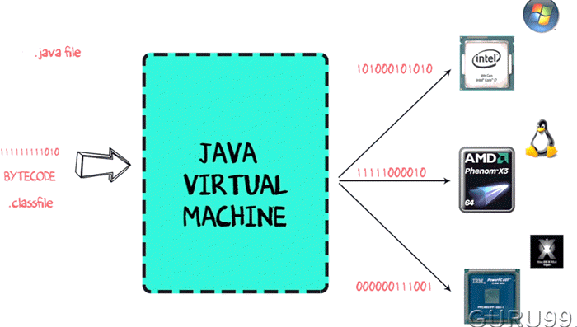
How JVM works

Slide 20
What is the difference between bytecode, native code, machine code, and assembly code?
Bytecode: Intermediate, platform-independent code executed by a virtual machine.
Native Code: Platform-specific machine code executed directly by the CPU.
Machine Code: Binary instructions for the CPU, specific to architecture.
Assembly Code: Human-readable representation of machine code, requiring an assembler for conversion.

Slide 21
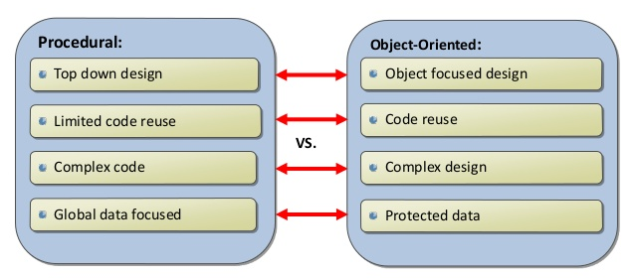
Procedural vs Object Oriented language

Slide 22
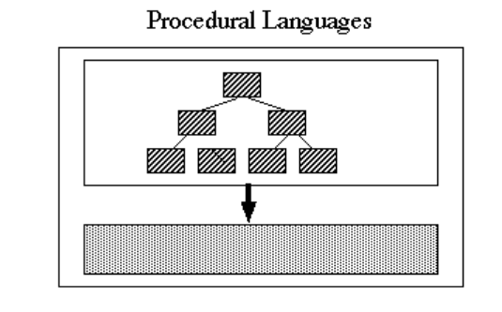
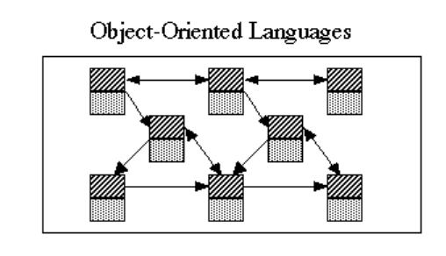
Procedural vs Object oriented language

Slide 23
What are the Features of OOP ???
Data Encapsulation
Behavior + Data Together [Encapsulated in class]
Reusability
Object & class-based reuse
Inheritance
Polymorphism
Real-World Modeling
Class abstraction and modeling
Modularity
Built-in through class system

Slide 24
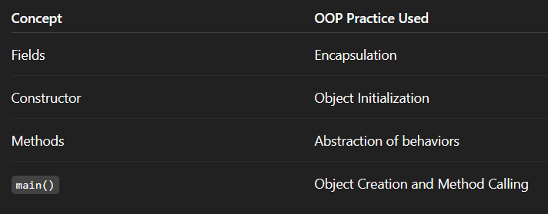
Conceptual entities & OOP practices

Slide 25
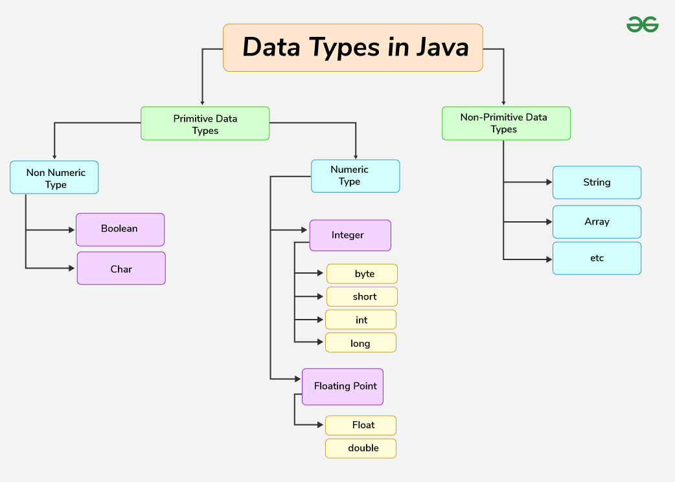
Data types
* Taken from geeks for geeks

Slide 26
Data Types
There are eight primitive data types in Java:
byte: 8-bit integer, range from -128 to 127
short: 16-bit integer, range from -32,768 to 32,767
int: 32-bit integer, range from -2,147,483,648 to 2,147,483,647
long: 64-bit integer, range from -9,223,372,036,854,775,808 to 9,223,372,036,854,775,807
float: 32-bit floating-point number
double: 64-bit floating-point number
boolean: Represents true or false values
char: 16-bit Unicode character

Slide 27
Variable
Local Variables:
Declared inside a method, constructor, or block of code. They are only accessible within that specific scope.
Instance Variables:
Declared within a class but outside any method. Each object (instance) of the class has its own copy of instance variables
Static Variables:
Declared with the static keyword. They belong to the class itself rather than to any specific instance. All instances of the class share the same static variable

Slide 28
public static void main (String[] args)
Public: This access modifier ensures that the method can be accessed from anywhere, even outside the class it's defined in. This is necessary for the JVM to be able to call and execute the main method
Static: This keyword allows the method to be called directly without creating an instance (object) of the class.
The JVM can call the main method without having to create an object of the class
Void: This indicates that the method does not return any value.
Main: This is the special method name that the JVM uses to identify the entry point of the program

Slide 29
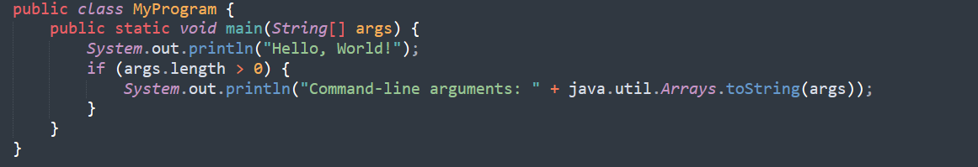
public static void main(String[] args)
This parameter is an array of strings, which can be used to pass command-line arguments to the program when it is running

Slide 30
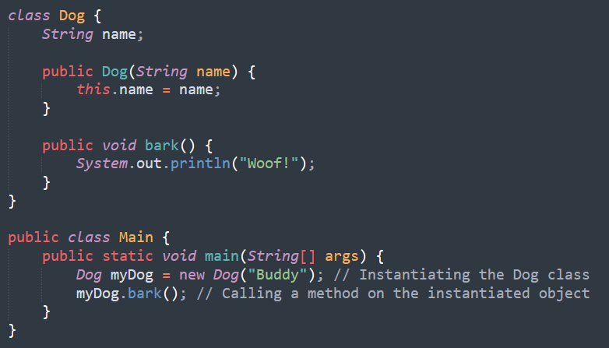
Objects
In Java, "instantiates" means creating a new object of a class. It's the process of allocating memory for an object and initializing its state using a constructor.
The new keyword is used to instantiate a class.
In this example, new Dog (“Buddy”) instantiates the Dog class by creating a Dog object named myDog. The constructor Dog (“String name”) is called to initialize the object state. After instantiation, you can access the object's methods and fields.

Slide 31
Class
A class in Java serves as a blueprint for creating objects, encapsulating data (fields) and behaviors (methods) into a single unit.
It defines the structure and functionality that objects of that class will possess.
Classes are fundamental to object-oriented programming in Java, promoting code organization, reusability, and maintainability.

Slide 32
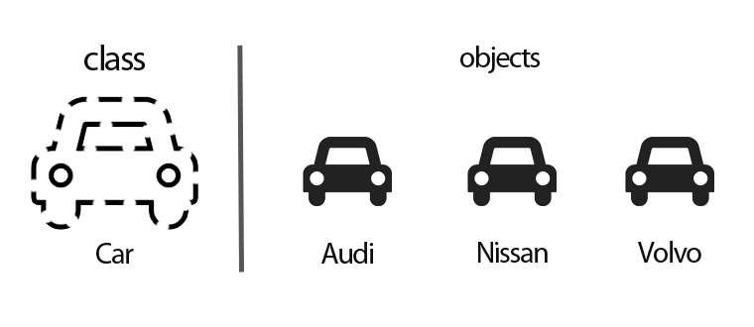
Class and objects

Slide 33
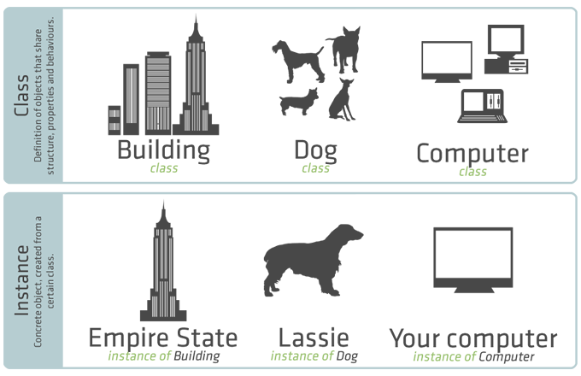
Object vs (Object)Instance
Object
Collection of objects
Defines object properties, behavior and structure.
Instance
Concrete object
Created from a particular class
Concrete objects has the physical reference to the base class,
Example: empire state building has reference to the building class

Slide 34
Constructors
Same Name as the Class
No Return Type
Automatically Called on Object Creation
Used to Set Initial Values for Object Attributes

Slide 35
Why Do We Need Constructors in Java

Slide 36
Why Do We Need Constructors in Java
Objects might have undefined or default values.
Extra initialization methods would be required.
Risk of improper object state

Slide 37
Types of Constructors in Java
Default Constructor
Parameterized Constructor
Copy Constructor

Slide 38
Control statements in Java
if
Executes a block of code if a condition is true.
if-else
Executes one block of code if the condition is true and another if it's false.
if-else-if
Checks multiple conditions sequentially, executing the corresponding block for the first true condition.
Switch
Selects one block of code to execute from multiple options based on the value of an expression

Slide 39
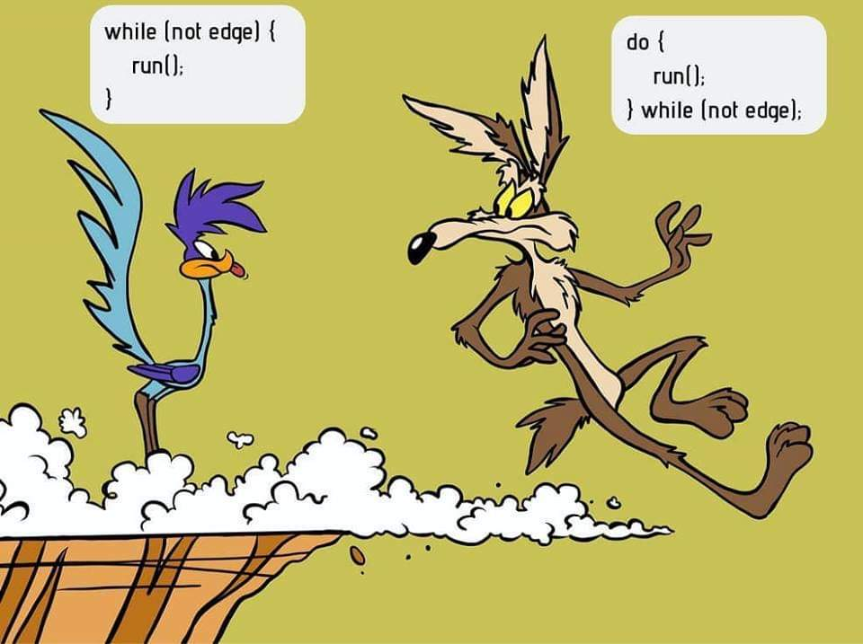
While vs do-while
While:
Executes the loop as long as the condition is true
Do - While:
Executes the loop at least once even the condition is false

Slide 40
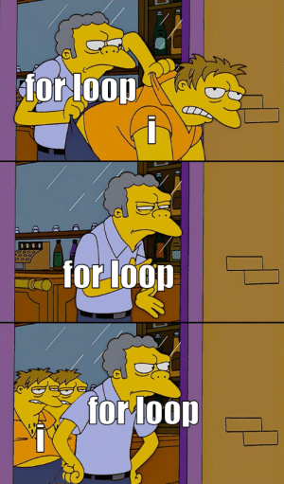
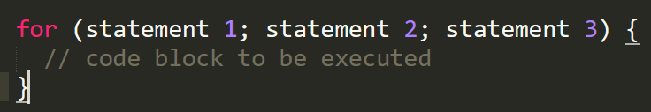
For loop
When you know exactly how many times you want to loop through a block of code.
Statement 1 is executed (one time) before the execution of the code block.
Statement 2 defines the condition for executing the code block.
Statement 3 is executed (every time) after the code block has been executed.

Slide 41
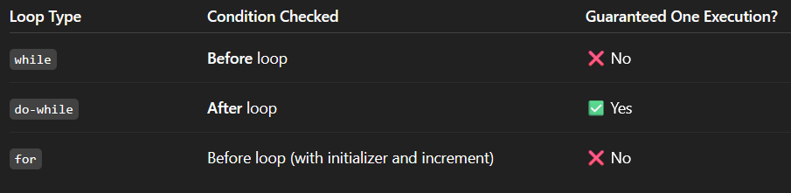
Loop Behaviour

Slide 42
Where to use for loop and while loop

Slide 43
Where to use for loop and while loop
While loop is used in situations where we do not know how many times loop needs to be executed.
For loop is used where we already know about the number of times loop needs to be executed. Typically for a index used in iteration.

Slide 44
Break and continue
Break
When the break statement is encountered inside a loop, the loop is immediately terminated and the program control resumes at the next statement following the loop.
Continue
The continue keyword can be used in any of the loop control structures. It causes the loop to immediately jump to the next iteration of the loop. In a for loop, the continue keyword causes control to immediately jump to the update statement

Slide 45
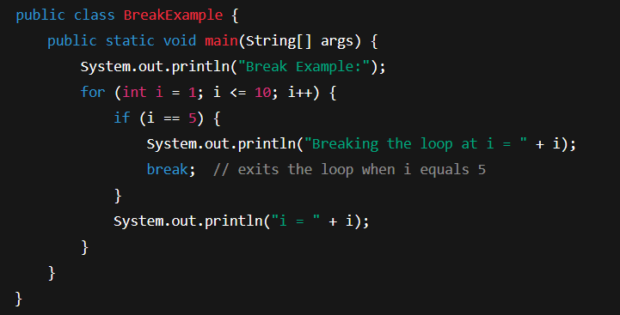
Break

Slide 46
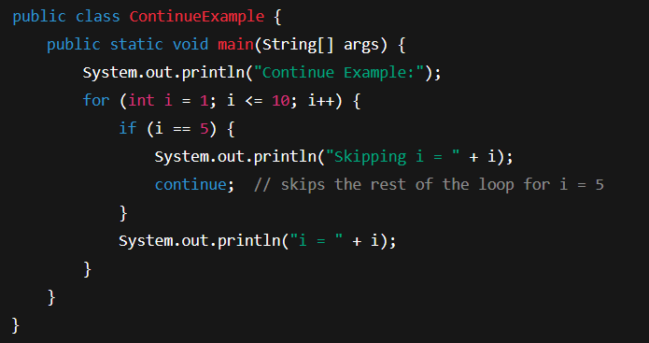
continue

Slide 47
Arrays
Arrays are used to store multiple values in a single variable, instead of declaring separate variables for each value.
or
Arrays in Java are one of the most fundamental data structures that allow us to store multiple values of the same type in a single variable.
To declare an array, define the variable type with square brackets:
String[] cars; or String cars[];
String[] cars = {"Volvo", "BMW", "Ford", "Mazda"};
int[] myNum = {10, 20, 30, 40};

Slide 48
Key features of Arrays
Contiguous Memory Allocation (for Primitives): Java array elements are stored in continuous memory locations, which means that the elements are placed next to each other in memory.
Zero-based Indexing: The first element of the array is at index 0.
Fixed Length: Once an array is created, its size is fixed and cannot be changed.
Can Store Primitives & Objects: Java arrays can hold both primitive types (like int, char, boolean, etc.) and objects (like String, Integer, etc.)

Slide 49
Basics of Arrays in Java
Array Declaration
type[] arrayName;

Slide 50
Create an Array
Create an Array
int[] numbers = new int[5];

Slide 51
Change an Array Element
// Changing the first element to 20 numbers[0] = 20;

Slide 52
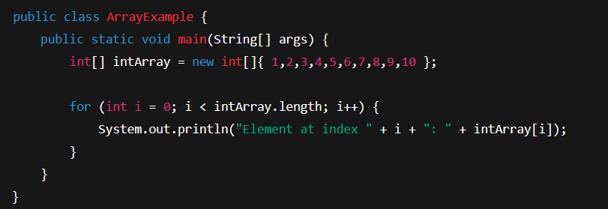
Array Length
We can get the length of an array using the length property
int length = numbers.length;

Slide 53
Access an Element of an Array
// Setting the first element of the array numbers[0] = 10;
// Accessing the first element int firstElement = numbers[0];

Slide 54
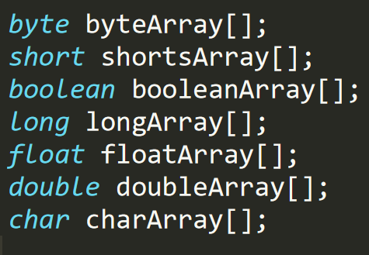
Data types & Array declaration

Slide 55
Allocating memory to array elements
intArray = new int[20];
Array literals
int[] intArray = new int[]{ 1,2,3,4,5,6,7,8,9,10 };

Slide 56
int[] numbers = {1, 2, 3, 4, 5}; // Array literal
int[] numbers = new int[5];
numbers[0] = 1;
numbers[1] = 2;
numbers[2] = 3;
numbers[3] = 4;
numbers[4] = 5;

Slide 57
Inheritance, Polymorphism, Packages and Interfaces

Slide 58
Inheritance: Inheritance Hierarchies, super keyword – final keyword-final classes and methods. Polymorphism: dynamic binding, method overriding. Abstraction-abstract classes and methods. The Object class –– Object Cloning – Inner Classes-Garbage Collection - Finalize Method.
Packages and Interfaces -Interfaces - Interfaces vs. Abstract classes, defining an interface, implementing, Inner classes - uses of inner classes, local inner classes, anonymous inner classes, static inner classes. interfaces - extending interfaces.

Slide 59
Inheritance
Inheritance in Java is a mechanism in which one class acquires the properties (fields and methods) of another class.
It is a fundamental concept of object-oriented programming (OOP) that allows for code reusability and the creation of hierarchical relationships between classes.
The class that inherits properties is known as the subclass (or derived class or child class), and the class whose properties are inherited is known as the superclass (or base class or parent class).

Slide 60
Inheritance Types in Java
Single Inheritance – One subclass inherits one superclass
Multilevel Inheritance – Class B inherits A, Class C inherits B
Hierarchical Inheritance – Multiple classes inherit one superclass
Note: Java does not support multiple inheritance (via classes) directly to avoid ambiguity, but it supports it via interfaces.

Slide 61
Benefits
Code Reusability
Method Overriding
Polymorphism
Abstraction
Modularity

Slide 62
Method overloading vs method overriding
Method Overloading allows us to define multiple methods with the same name but different parameters within a class.
This difference can be in the number of parameters, the types of parameters, or the order of those parameters.
Method overloading in Java is also known as Compile-time Polymorphism, Static Polymorphism, or Early binding

Slide 63
Key features of Method Overloading:
Multiple methods can share the same name in a class when their parameter lists are different.
Overloading is a way to increase flexibility and improve the readability of code.
Overloading does not depend on the return type of the method, two methods cannot be overloaded by just changing the return type.

Slide 64
Method Overriding
Method overriding, in object-oriented programming, is a language feature that allows a subclass or child class to provide a specific implementation of a method that is already provided by one of its superclasses or parent classes

Slide 65
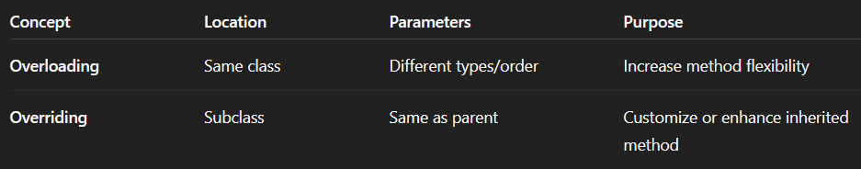
Method overloading vs method overriding

Slide 66
super Keyword
Super keyword is used to refer to the parent class in a subclass.
Call the parent class constructor.
Access methods and variables from the parent class.

Slide 67
Final keyword
Mark variables as constants.
Prevent method overriding.
Prevent class inheritance.

Slide 68
Final method

Slide 69
Final class

Slide 70
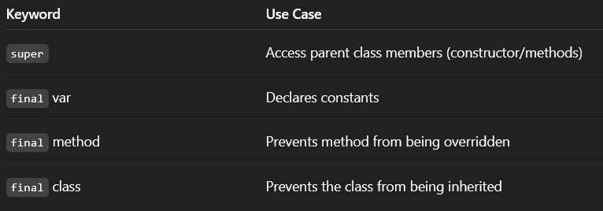
Behaviour of the final keyword

Slide 71
Polymorphism?
Polymorphism means "many forms". In Java, it allows us to perform a single action in different ways.
Compile-Time Polymorphism (Method Overloading)
Run-Time Polymorphism (Method Overriding)

Slide 72
Dynamic binding
Dynamic binding is the mechanism that determines which overridden method to call at runtime.
When the JVM decides at runtime which method to invoke, based on the object type the reference points to

Slide 73
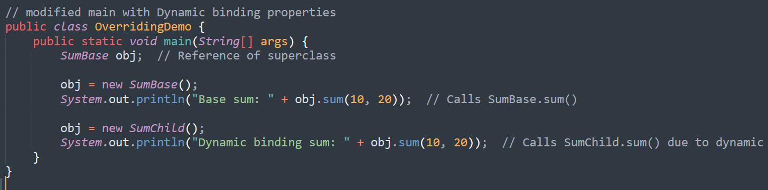
What is Method Overriding here? In our example
The SumChild class overrides the sum() method of SumBase
It changes the logic by adding +10 to the result.

Slide 74
Abstract classes
An abstract class is a class that cannot be instantiated (created directly).
It acts as a blueprint for other classes, defining a general structure or behavior.
Abstract classes can contain both abstract methods (without implementation) and concrete methods (with implementation).
An abstract class is declared using the abstract keyword.
Any class containing one or more abstract methods must also be declared abstract

Slide 75
Abstract Methods
An abstract method is a method declared without a body (implementation).
It specifies the method's signature (name, parameters, return type) but not the actual code that executes when the method is called.
Abstract methods must be implemented by subclasses that inherit from the abstract class.

Slide 76
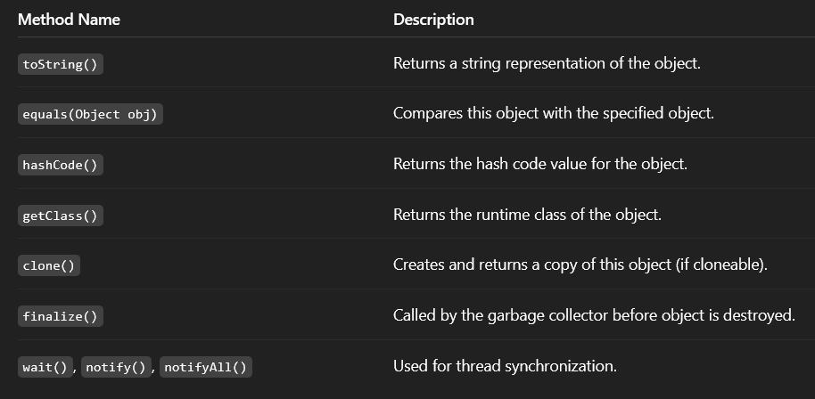
Object Class
Object class in Java is present in java.lang package.
Every class in Java is directly or indirectly derived from the Object class.

Slide 77
Abstraction- abstract classes and methods
Abstract is the modifier applicable only for methods and classes but not for variables.
Even though we don't have implementation still we can declare a method with an abstract modifier.
Abstract methods have only declaration but not implementation.
Abstract method declaration should compulsory ends with semicolons.

Slide 78
Garbage Collection
GC is the process of automatically identifying and removing unused (unreachable) objects from memory to free up resources and prevent memory leaks.

Slide 79
Finalize Method
It is a special method that used to be part of the object destruction process

Slide 80
Interfaces
An interface in Java is a blueprint of a behaviour.
A Java interface contains static constants and abstract methods.
Uses keyword implememts

Slide 81
Properties
The interface in Java is a mechanism to achieve abstraction.
By default, variables in an interface are public, static, and final.
It is used to achieve abstraction and multiple inheritance in Java.
It supports loose coupling (classes depend on behavior, not implementation).
In other words, interfaces primarily define methods that other classes must implement.

Slide 82
can we create object for interface?
Not possible

Slide 83
When to use classes and interfaces ??
To create real objects with properties and behaviors
When you have shared implementation (code)
When you need constructors, fields, method implementations, and inheritance
Note: Use Class when you have specific data and functionality.

Slide 84
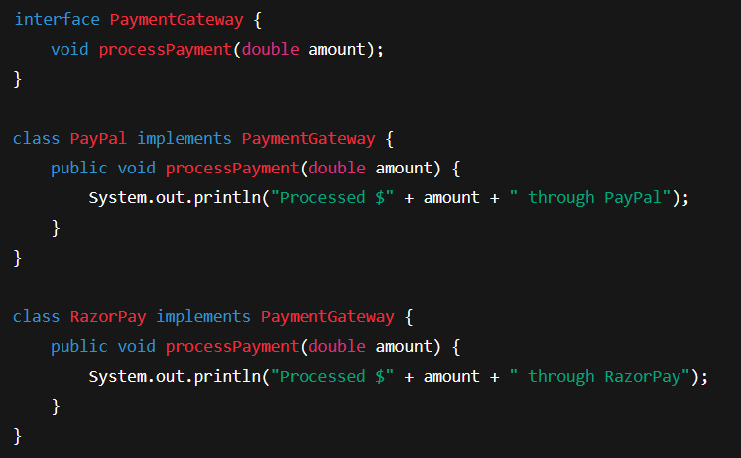
When to use interfaces ??
To define a contract or blueprint without implementation.
When you want to enforce rules across unrelated classes.
For loose coupling, polymorphism, and plug-and-play behavior.

Slide 85
Inner classes
Member Inner Class [A class defined within another class, but not declared as static]
Static Nested Inner Class [A static nested class in Java is a class declared within another class using the static keyword].
Local Inner Class [A local inner class in Java is a class defined within a block of code, typically inside a method.]
Anonymous Inner Class [An anonymous inner class in Java is a class without a name, defined and instantiated in a single statement. It is used to create objects of a class or interface with specific behavior, often for one-time use.]

Slide 86
Key characteristics of Anonymous Inner Class :
No Name: It has no explicit name.
Single Object: Only one object is created from it.
Extends or Implements: It either extends a class or implements an interface.
Defined Inside Another Class: It must be defined within another class (inner class).
No Constructor: It cannot have a constructor due to the lack of a name. However, it can use an instance initializer block for initialization.
One-Time Use: Typically used when a class is only needed once, avoiding the creation of a separate named class.

Slide 87
Module No. 4 | Exception Handling
Exceptions – Exception Hierarchy-Throwing and Catching Exceptions-Multiple Catch Clause-Nested Try statement- throw-throws-finally- Built in exceptions - User Defined Exceptions.

Slide 88
Error vs. Exception
Aspect | Error | Exception
Definition | An Error indicates a serious problem that a reasonable application should not try to catch. | Exception indicates conditions that a reasonable application might try to catch
Cause | Caused by issues with the JVM or hardware. | Caused by conditions in the program such as invalid input or logic errors.
Examples | OutOfMemoryError StackOverFlowError | IOException NullPointerException

Slide 89
Exception Handling
Exception handling in Java is a mechanism to manage runtime errors, ensuring the program's normal flow is maintained.
Exceptions are events that disrupt the program's execution, typically caused by unexpected conditions like invalid input or resource unavailability.

Slide 90
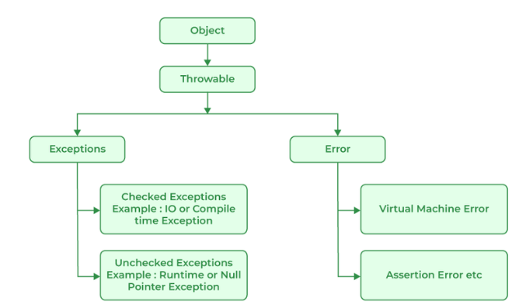
Java Exception Hierarchy
All exception and error types are subclasses of the class Throwable, which is the base class of the hierarchy

Slide 91
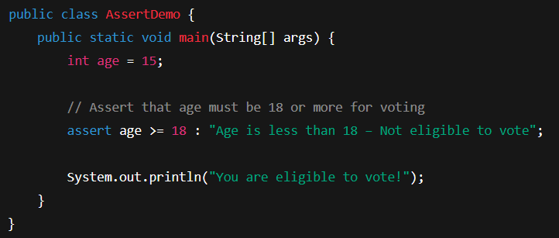
Assertion Error
An assertion allows testing the correctness of any assumptions that have been made in the program.
An AssertionError in Java is a type of error that occurs when an assert statement evaluates to false.

Slide 92
Exceptions can occur due to between several reasons, such as:
Invalid user input
Device failure
Loss of network connection
Physical limitations (out-of-disk memory)
Code errors
Out of bound
Null reference
Type mismatch
Opening an unavailable file
Database errors
Arithmetic errors

Slide 93
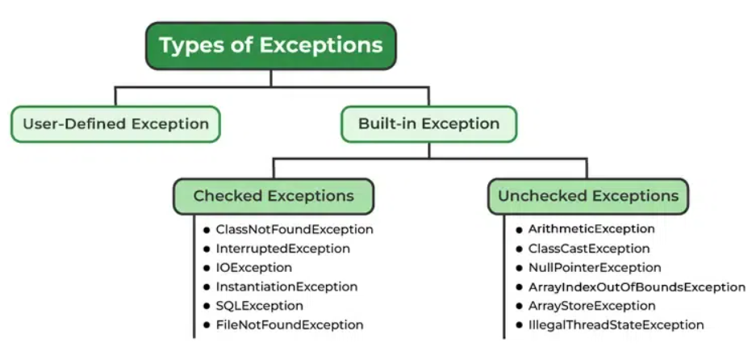
Types of Exception Handling

Slide 94
Exceptions Category
Built-in Exceptions
Checked Exception
Unchecked Exception
User-Defined Exceptions

Slide 95
Built-in Exception
Build-in Exception are pre-defined exception classes provided by Java to handle common errors during program execution.
Two types
Checked Exception
Unchecked Exception

Slide 96
Built-in Exception - Checked Exceptions [Compile Time]
ClassNotFoundException: Throws when the program tries to load a class at runtime but the class is not found.
InterruptedException: Thrown when a thread is paused and another thread interrupts it.
IOException: Throws when input/output operation fails
InstantiationException: Thrown when the program tries to create an object of a class but fails because the class is abstract, an interface, or has no default constructor.
SQLException: Throws when there's an error with the database.
FileNotFoundException: Thrown when the program tries to open a file that doesn’t exist

Slide 97
Built-in Exception - UnChecked Exceptions [Runtime]
ArithmeticException: It is thrown when there's an illegal math operation.
ClassCastException: It is thrown when you try to cast an object to a class it does not belong to.
NullPointerException: It is thrown when you try to use a null object (e.g. accessing its methods or fields)
ArrayIndexOutOfBoundsException: This occurs when we try to access an array element with an invalid index.
ArrayStoreException: This happens when you store an object of the wrong type in an array.
IllegalThreadStateException: It is thrown when a thread operation is not allowed in its current state

Slide 98
throw and throws
Feature | throw | throws
Definition | It is used to explicitly throw an exception. | It is used to declare that a method might throw one or more exceptions.
Location | It is used inside a method or a block of code. | It is used in the method.
Usage | It can throw both checked and unchecked exceptions. | It is only used for checked exceptions. Unchecked exceptions do not require throws
Responsibility | The method or block throws the exception. | The method's caller is responsible for handling the exception.
Flow of Execution | Stops the current flow of execution immediately. | It forces the caller to handle the declared exceptions.
Example | throw new ArithmeticException("Error"); | public void myMethod() throws IOException {}

Slide 99
Finally block.
The "finally block" is used in exception handling to ensure that a certain piece of code is always executed whether an exception occurs or not.

Slide 100
Is it possible for a developer to define an explicit exception?

Slide 101
Is it possible to handle exception without catch and finally block?
Yes, it is technically possible to handle exceptions in Java without using catch or finally, by using the throws keyword

Slide 102
Exception block - Behaviour
Concept | Valid?
try without catch or finally | ❌ Invalid
catch without try | ❌ Invalid
try with only finally | ✅ Valid
throws without try-catch | ✅ Valid

Slide 103
Module 5:
Collection, overview, Collection interface –List, Set, Map, Collection Classes- Array List, HashSet, HashMap- Using an Iterator- For-Each-Comparators, Wrapper classes.

Slide 104
Write a code to build a student management system that stores marks of 5 students, Calculate total & average

Slide 105
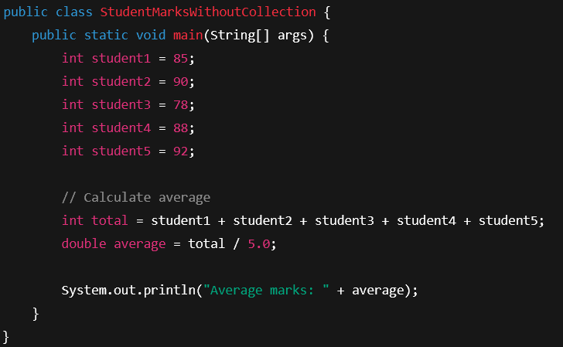
Write a code to build a student management system that stores marks of 5 students, Calculate total & average

Slide 106
Problems with the existing objects
Difficult to manage if the number of students increases. [Assume for 1000 students]
Can't loop over values [Variables].
Repetitive, error-prone code.
Poor scalability and maintainability.

Slide 107
Before Collections, developers used arrays to store data. But arrays have several limitations:
Fixed size (can’t grow or shrink)
Only store elements of the same type
No built-in methods to sort, search, or manipulate data easily

Slide 108
Collections!!!!
Imagine managing hundreds or thousands of data points using separate variables. It’s chaotic!
Collections provide a structured and efficient way to store, access, and manipulate large groups of data using a single object.

Slide 109
Java Collections Framework (JCF)
A unified architecture for representing and manipulating collections.
Reduces programming effort
Increases performance and reliability
Promotes interoperability between APIs

Slide 110
Collections
Interfaces - List, Set, Map, Queue
Classes - ArrayList, HashSet, HashMap

Slide 111
Collection interfaces – List, Set, Map
Interface | What It Stores | Key Feature
List | Ordered collection | Allows duplicates
Set | Unique elements | No duplicates allowed
Map | Key-value pairs | Fast lookups via key
Queue | Elements for processing (FIFO) | Insertion/removal rules

Slide 112
Collection Classes - ArrayList, HashSet, HashMap
Feature | ArrayList | HashSet | HashMap
Use-case | Ordered list | Unique items | Key-Value pairs
Duplicates | ✅ Allowed | ❌ Not allowed | ❌ Keys: No, ✅ Values: Yes
Maintains Order | ✅ Yes | ❌ No | ❌ No (use LinkedHashMap)
Key Lookup | ❌ No | ✅ Yes | ✅ Yes (by key)
Internal Structure | Array | Hash table | Hash table

Slide 113
Collection Classes – Methods [ArrayList]
Method | Description
add(E e) | Adds an element to the end of the list
add(int i, E e) | Inserts element at specific index
get(int i) | Returns the element at specified index
set(int i, E e) | Replaces element at given index with new value
remove(int i) | Removes element at specified index
size() | Returns the number of elements in the list
contains(E e) | Returns true if element exists in the list
indexOf(E e) | Returns index of first occurrence of element
clear() | Removes all elements
isEmpty() | Checks if the list is empty

Slide 114
Collection Classes – Methods [HashSet]
Method | Description
add(E e) | Adds element if it’s not already present
remove(E e) | Removes the specified element
contains(E e) | Returns true if the element exists
size() | Returns number of elements
isEmpty() | Checks if set is empty
clear() | Removes all elements
iterator() | Returns an iterator over elements

Slide 115
Collection Classes – Methods [HashMap]
Method | Description
put(K key, V value) | Adds key-value pair or updates existing key
get(Object key) | Returns value for the given key
remove(Object key) | Removes entry by key
containsKey(K key) | Checks if a key exists
containsValue(V value) | Checks if a value exists
size() | Returns number of key-value pairs
isEmpty() | Checks if the map is empty
clear() | Removes all entries
keySet() | Returns a set of keys
values() | Returns a collection of values
entrySet() | Returns a set of key-value entries

Slide 116
Is java purely object oriented?
Is primitive data types (int, char, double, etc.) are not objects?

Slide 117

What Are Wrapper Classes? Why you need it.
Java is not 100% object-oriented, because primitive data types (int, char, double, etc.) are not objects.
But Java Collections (like ArrayList, HashSet, HashMap) can only store objects, not primitives.
To solve this, Java provides wrapper classes that “wrap” primitive types into objects.

Slide 118
List of Primitive Types and Their Wrapper Classes
Primitive Type | Wrapper Class
byte | Byte
short | Short
int | Integer
long | Long
float | Float
double | Double
char | Character
boolean | Boolean

Slide 119

Autoboxing and Unboxing
Java automatically converts between primitives and wrapper classes
Autoboxing: converting int → Integer
Unboxing: converting Integer → int

